Slide 1

movie recommendation system
M. Praveen - 309
K. Rakesh - 312

Slide 2


PROBLEM STATEMENT
Build a Movie Recommendation System, with a focus on finding similar movies based on content and keywords.
The system should analyse movie attributes such as plot overview, genres, and keywords to suggest relevant recommendations to users.
The goal is to create a personalized and accurate recommendation engine that enhances the user experience by offering tailored movie suggestions aligned with their preferences.

Slide 3
Different Approaches used in Recommendation Systems
Content-based filtering: This approach recommends items by analyzing the past preferences of a particular user.
Collaborative filtering: Collaborative filtering leverages the choices of similar users to suggest relevant items.
Hybrid recommender systems: These systems merge content-based and collaborative filtering, targeting accuracy and diversity in recommendations.
Knowledge-based systems: Tailored for specific scenarios, these systems make recommendations based on detailed user and item information.

Slide 4

DATASET
The dataset appears to contain information about movies, with each row representing a different movie. Here's an overview of the columns
(total 9 data columns):
Index: A label for rows in a dataset.
Budget: Money spent on making a movie.
Genres: Categories like action or comedy for movies.
Homepage: Main webpage of a website.
ID: Unique number for each record.
Keywords: Important words for a movie's topic.
Original Language: Language a movie was first made in.
Original Title: Title of a movie when it was released.
Overview: Brief summary of a movie.
Popularity: How well-known a movie is.

Slide 5
Libraries Used:
Pandas: Pandas is a powerful Python library used for data manipulation and analysis. It offers data structures and operations for manipulating numerical tables and time series.
numpy: This library is fundamental for numerical computing in Python. It provides support for large, multi-dimensional arrays and matrices, along with a collection of mathematical functions to operate on these arrays efficiently.
scikit-learn (sklearn): Scikit-learn is a machine learning library for Python. It provides simple and efficient tools for data mining and data analysis. In this code, it's used for text vectorization (CountVectorizer) and calculating cosine similarity.
sklearn.feature_extraction.text.CountVectorizer: This is a feature extraction method provided by scikit-learn (sklearn). It converts a collection of text documents into a matrix of token counts. This is often used in natural language processing (NLP) tasks.
sklearn.metrics.pairwise.cosine_similarity: Another function from scikit-learn, this calculates the cosine similarity between pairs of samples in two matrices. It's often used in recommendation systems and text analysis to measure the similarity between documents or vectors in a high-dimensional space

Slide 6
process:
This code performs the following steps:
Imports necessary libraries.
Reads movie data from a CSV file into a DataFrame.
Preprocesses the data by handling missing values and combining selected features into a single string.
Uses CountVectorizer to convert the combined text data into a matrix of token counts.
Calculates cosine similarity between movies based on their combined features.
Defines functions to retrieve movie titles from their indices and vice versa.
Specifies a movie the user likes and finds similar movies based on cosine similarity.
Prints the top 10 similar movies to the user's preferred movie.

Slide 7
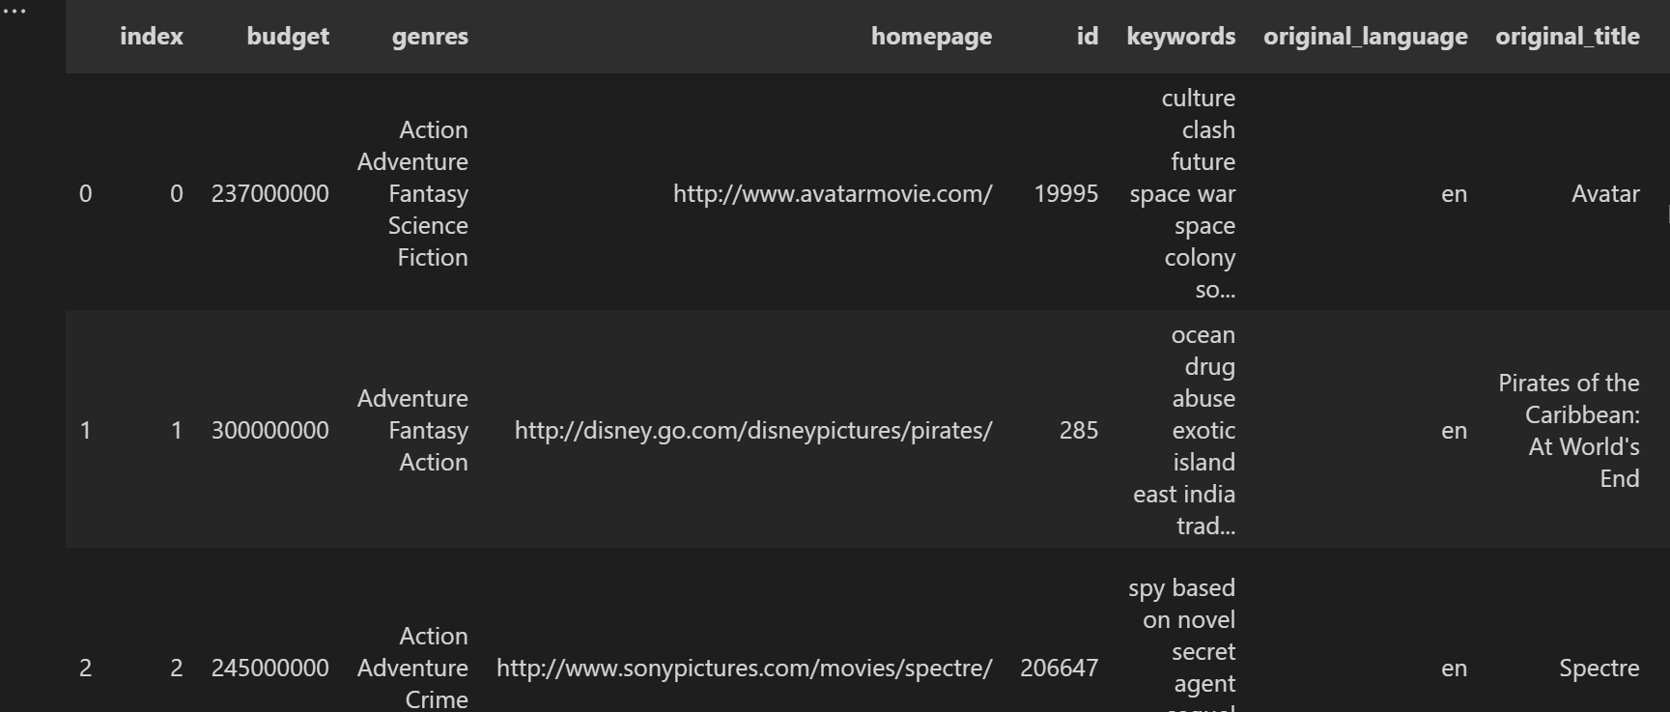

Slide 8
conclusion:
Content-based recommendation systems leverage item features such as genre, plot summaries, or ingredients to suggest personalized recommendations to users.
These systems enhance user experience by providing relevant suggestions without relying on explicit user feedback.
They are valuable in domains ranging from entertainment to cooking, improving user engagement and satisfaction.

